Slide 1
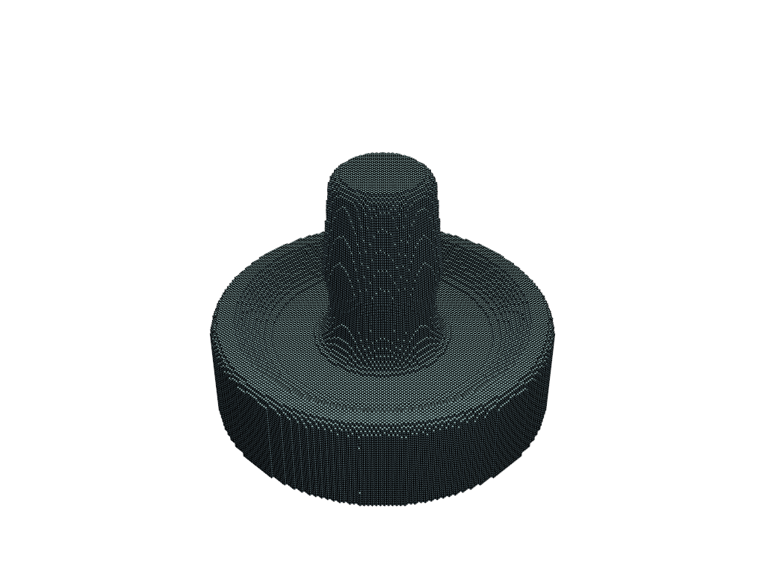
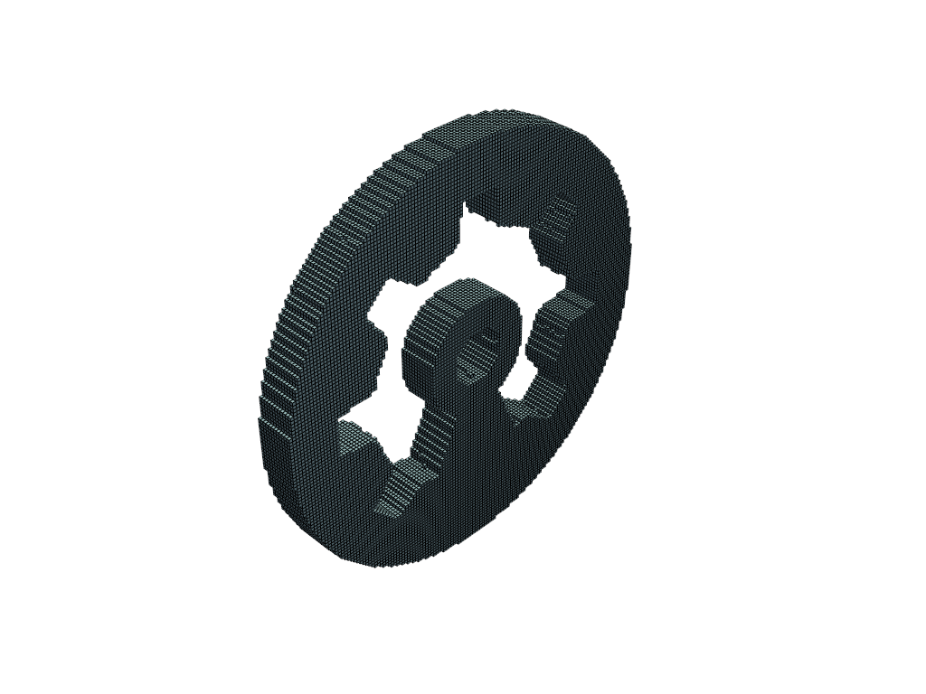
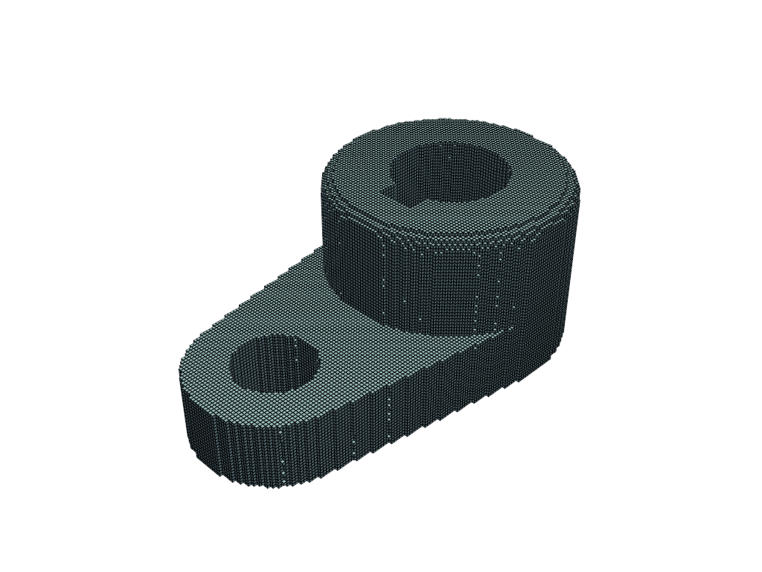
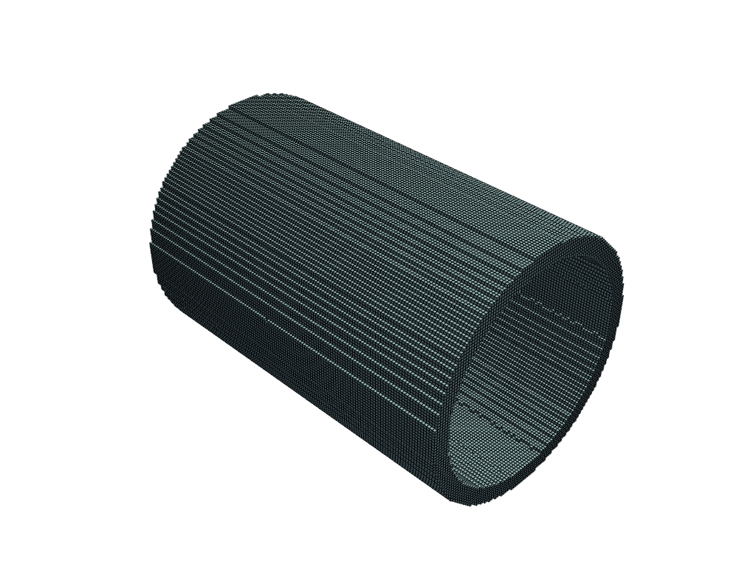
Integrating Geometrical Part Information using Neural Network Models for Injection Molding Quality Prediction
Maarten Van Roy
Promotor: Prof. Dr. Ir. Mathias Verbeke
Copromotor: Ing. Quinten Danneels
Degree of Master of Science in Artificial Intelligence, option Engineering and Computer Science

Slide 2
Overview
Context
Quality prediction / state-of-the-art
Methodology
Data Collection
Thesis Models
Results
Conclusion

Slide 3
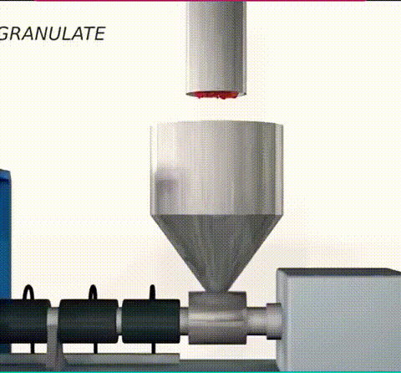
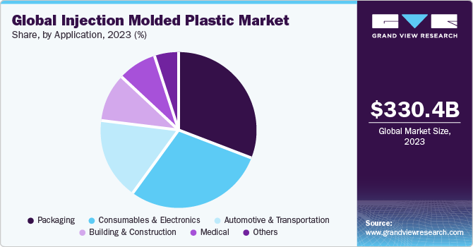
Context
High precision, mass production
Most widely used plastic production method
https://www.grandviewresearch.com/industry-analysis/social-commerce-market, www.tronicarts.de

Slide 4
Quality Prediction
Many variables with complex relations
Geometry
Temperature, Pressure, Injection Time, …
Many possible defects:
www.vem-tooling.com

Slide 5
State-of-the-Art Quality Prediction A.I.
…-1999
2000s
Still lack of generalization
Mathematical models, reliance on expert knowledge
2020s
Early application of simple MLPs
Transfer-Learning, Deep Learning, …

Slide 6
Problem Statement – Research Question
Add generalization with geometry
Can we encode global geometry with an Autoencoder by training on a big dataset (ABC-Dataset)?
MLP

Slide 7
Methodology – Direct Latent Space Model

Slide 8
Methodology – Direct Latent Space Model
Geometry Parameters

Slide 9
Methodology – Direct Latent Space Model
Process Parameters

Slide 10
Methodology – Direct Latent Space Model
Gate Location Parameters

Slide 11
Methodology – Direct Latent Space Model
Quality Metrics

Slide 12
Methodology – SubNetwork Model
Fusion Network
Geometry Network
Process Parameter Network

Slide 13
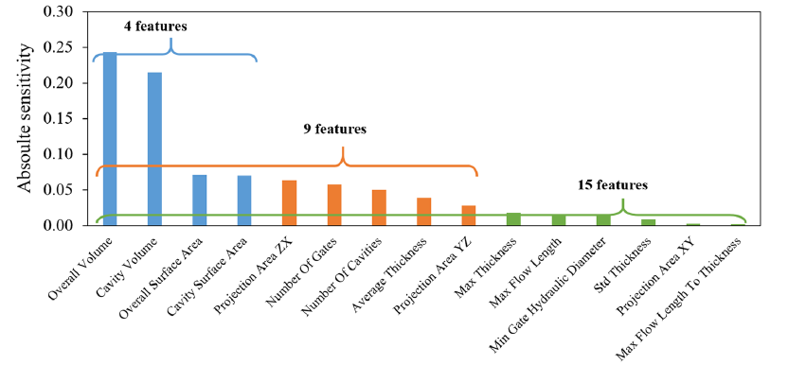
Methodology - Benchmark System
Benchmark system to analyze performance
Based on research by Lee, C., et al. (2020)
Uses specific features and same machine set parameters as thesis
A single MLP
Lee et al. (2020): Development of Artificial Neural Network System to Recommend Process Conditions of Injection Molding for Various Geometries

Slide 14
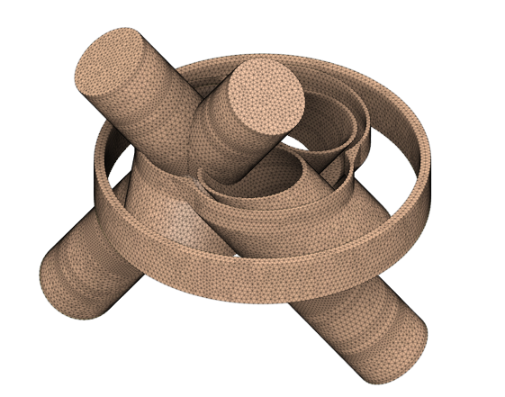
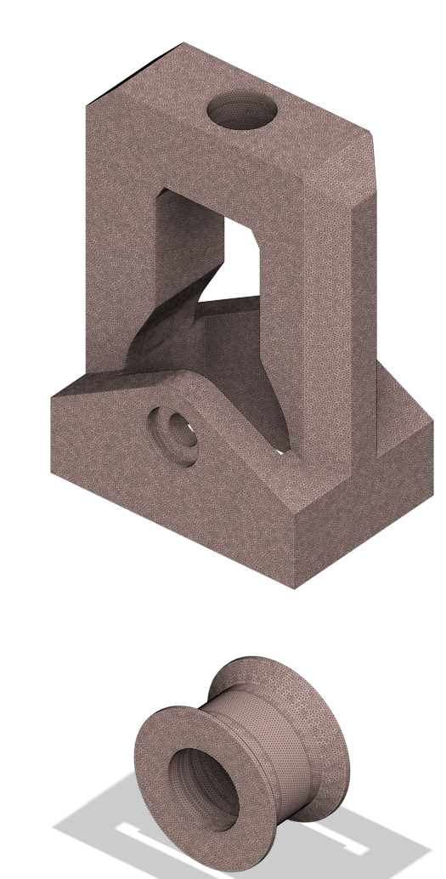
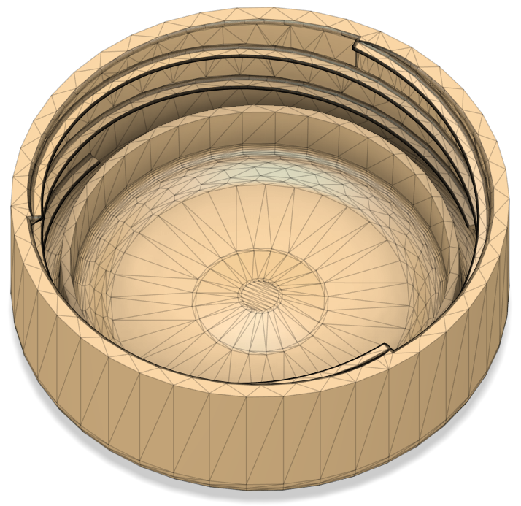
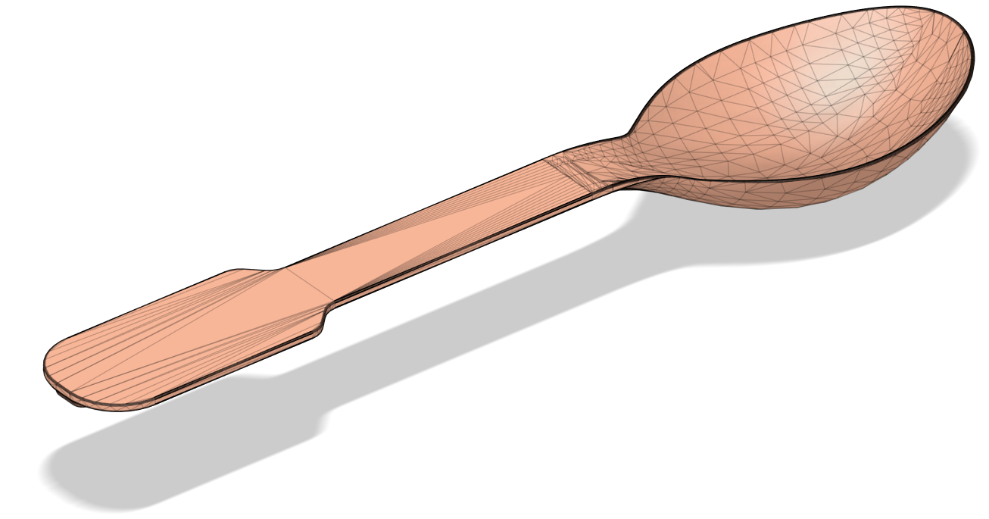
Methodology - Data Collection
The ABC dataset for autoencoder CAD models, voxelized
Moldflow with different dataset
23 products, 80 simulations each
D-Optimal design
Manual extraction for Benchmark features and gate location parameters
Fusion 360
https://archive.nyu.edu/handle/2451/43778

Slide 15
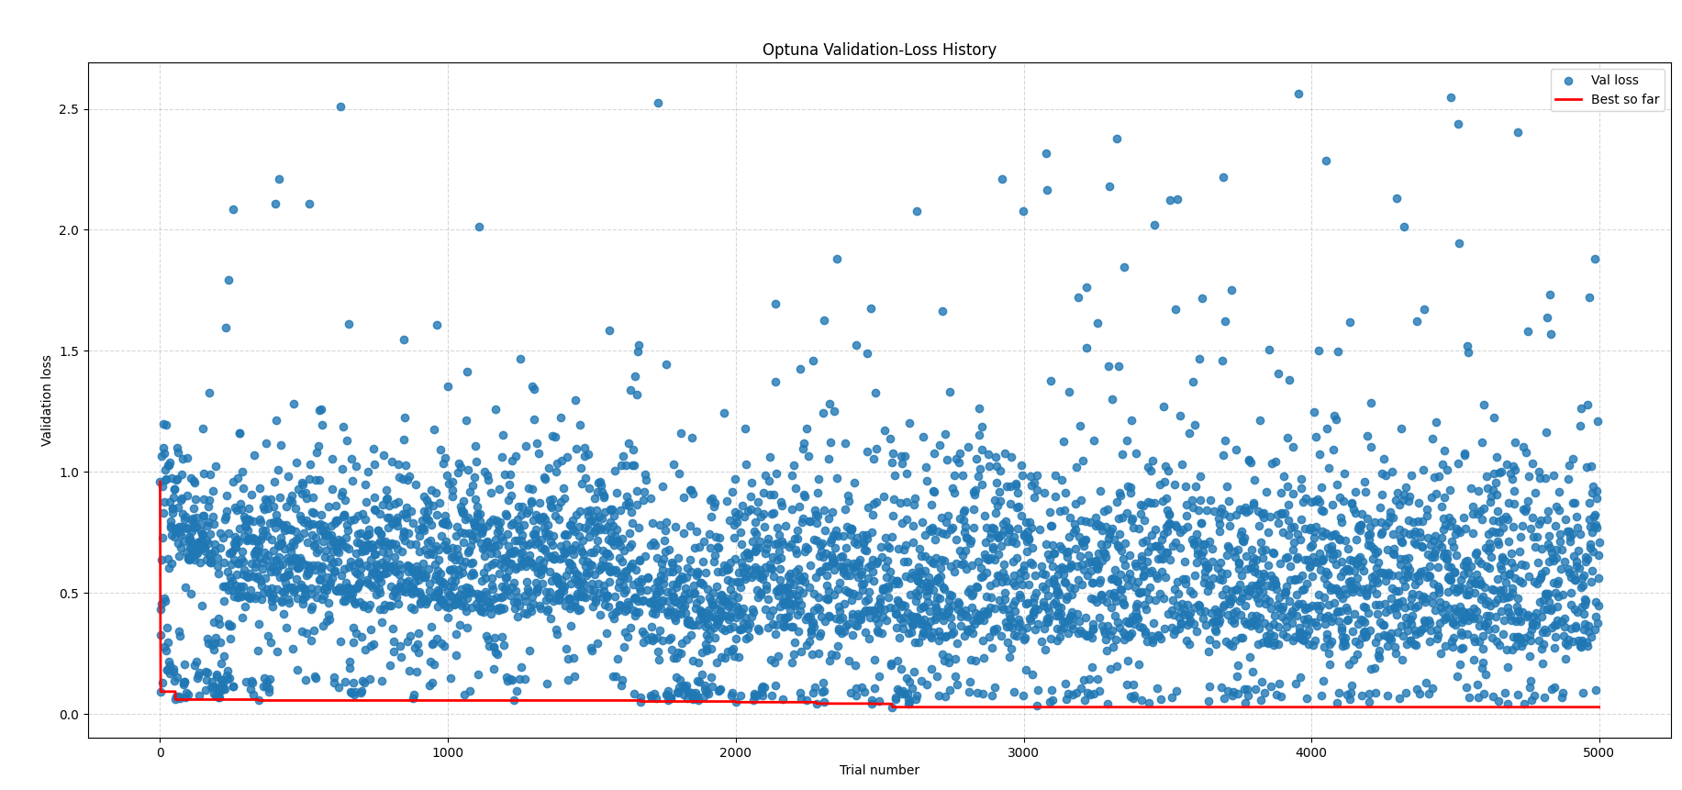
Methodology - NAS
Optuna Python library
Define hyperparameters to optimize

Slide 16
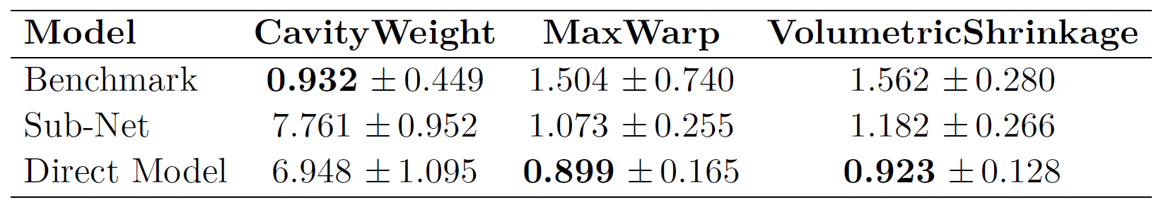

Results
K-fold cross validation
When outputs were normalized:
The target-specific MSE was:

Slide 17
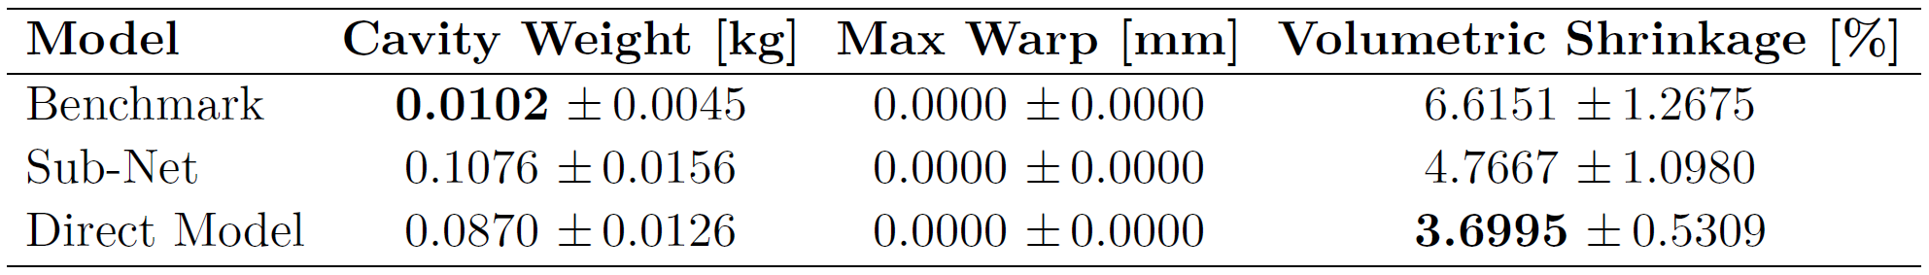
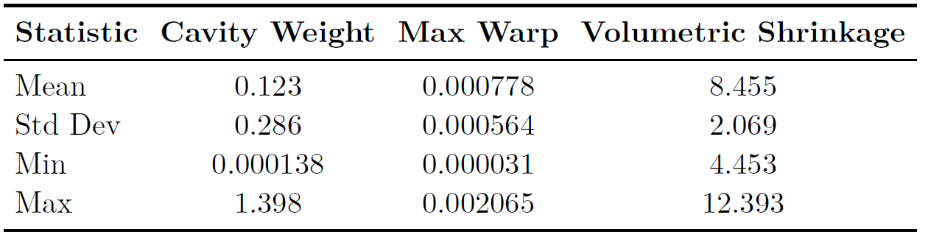
Results
Real-unit outputs:
target-specific MSE:
Quality metric data of the dataset:

Slide 18
Conclusion
Direct model
Best for warpage / shrinkage
Benchmark model
Best for cavity weight
Volume scalar
No transfer learning needed for generalization anymore
Useful for industrial use

Slide 19
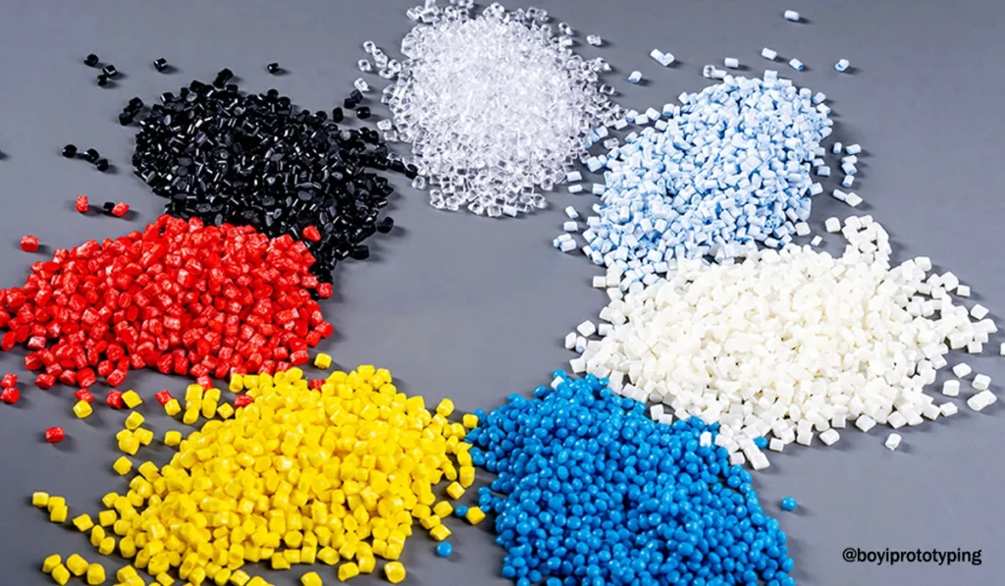
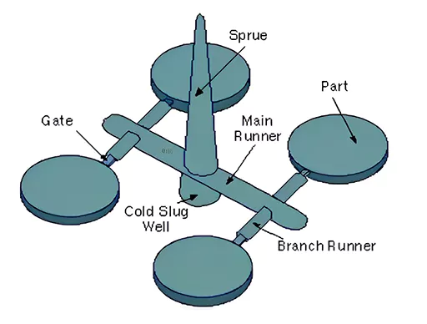
Future Work / Shortcomings
Extend the model
Polymers
Quality metrics
Bigger product dataset
Include sprue and gate systems
https://prototool.com/sprue-in-injection-molding/, https://www.boyiprototyping.com/injection-molding-guide/polypropylene-pellets-for-injection-molding/

Slide 20
Questions?

